Slide 1

How Great Thou Art

Slide 2

O Lord my God，When I in awesome wonder
Consider all the works Thy hands have made.
I see the stars, I hear the rolling thunder,
Thy power throughout the universe displayed.
主啊我神 我每逢举目观看 祢手所造 一切奇妙大工
看见星宿 又听到隆隆雷声祢的大能 遍满了宇宙中
Verse1

Slide 3
Then sings my soul, my Saviour God, to Thee
How great Thou art, how great Thou art!
Then sings my soul, my Saviour God, to Thee
How great Thou art, how great Thou art!
我灵歌唱 赞美救主我神 祢真伟大 何等伟大
我灵歌唱 赞美救主我神 祢真伟大 何等伟大
Chorus

Slide 4
In 4

Slide 5
And when I think，that God, His Son not sparing,
Sent Him to die, I scarce can take it in;
That on the cross,my burden gladly bearing,
He bled and died to take away my sin
当我想到 神竟愿差祂儿子 降世舍命 我几乎不领会
主在十架 甘愿背我的重担 流血舍身 为要赦免我罪
Verse2

Slide 6
Then sings my soul, my Saviour God, to Thee
How great Thou art, how great Thou art!
Then sings my soul, my Saviour God, to Thee
How great Thou art, how great Thou art!
我灵歌唱 赞美救主我神 祢真伟大 何等伟大
我灵歌唱 赞美救主我神 祢真伟大 何等伟大
Chorus

Slide 7
How Great! How Great! Hou Great Thou Art!
伟大！伟大！你真伟大！
Bridge*4

Slide 8
In 4

Slide 9
When Christ shall come with shout of acclamation
And take me home, what joy shall fill my heart!
Then I shall bow in humble adoration,
And there proclaim, my God, how great Thou art!
当主再来 欢呼声响彻天空 何等喜乐 主接我回天家
我要跪下 谦恭地崇拜敬奉 并要颂扬 神啊祢真伟大
Verse3

Slide 10
Then sings my soul, my Saviour God, to Thee
How great Thou art, how great Thou art!
Then sings my soul, my Saviour God, to Thee
How great Thou art, how great Thou art!
我灵歌唱 赞美救主我神 祢真伟大 何等伟大
我灵歌唱 赞美救主我神 祢真伟大 何等伟大
Chorus

Slide 11
How Great! How Great! Hou Great Thou Art!
伟大！伟大！你真伟大！
Bridge*4(end)

Slide 12
How Great Thou Art

Slide 13
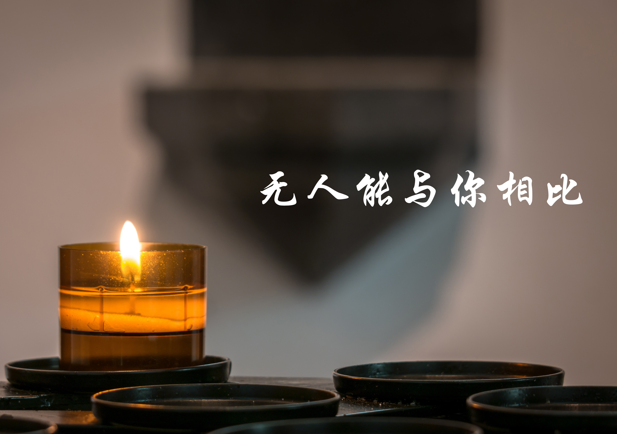

Slide 14

In 16

Slide 15
永活全能的主宰
道成肉身显明你的爱
奇妙主 荣耀神
何等的伟大
Yong huo quan neng de zhuzai
Dao cheng rou shen xian ming ni de ai
Qi miao zhu Rong yao shen He deng de wei da
Verse-1

Slide 16
圣洁尊贵的君王
超乎万名在全地之上
为我罪流宝血
赎回我生命
Shen jie zun gui de jun wang
Chao hu wan ming zai quan di zhishang
Wei wo zui liu bao xue
Shu hui wo sheng ming
Verse-2

Slide 17
无人能与你相比
你掌权直到永远
我要扬声赞美你
Wu ren neng yu ni xiang bi
Ni zhang quan zhi dao yong yuan
Wo yao yang sheng zan mei ni
Pre - Chorus

Slide 18
喔 何等伟大的爱
高过诸天深海 当受极大赞美 喔喔
喔 主你满有能力 世界盼望是你
我要敬拜你 耶稣我的主
Wo he deng wei da de ai Gao guo zhu tian shen hai
Dang shou ji da zan mei wo wo
Wo zhu ni man you neng li Shi jie pan wang shi ni
Wo yao jing bai ni Ye su wo de zhu
Chorus

Slide 19
In 8

Slide 20
永活全能的主宰
道成肉身显明你的爱
奇妙主 荣耀神
何等的伟大
Yong huo quan neng de zhuzai
Dao cheng rou shen xian ming ni de ai
Qi miao zhu Rong yao shen He deng de wei da
Verse-1

Slide 21
圣洁尊贵的君王
超乎万名在全地之上
为我罪流宝血
赎回我生命
Shen jie zun gui de jun wang
Chao hu wan ming zai quan di zhishang
Wei wo zui liu bao xue
Shu hui wo sheng ming
Verse-2

Slide 22
无人能与你相比
你掌权直到永远
我要扬声赞美你
Wu ren neng yu ni xiang bi
Ni zhang quan zhi dao yong yuan
Wo yao yang sheng zan mei ni
Pre - Chorus

Slide 23
喔 何等伟大的爱
高过诸天深海 当受极大赞美 喔喔
喔 主你满有能力 世界盼望是你
我要敬拜你 耶稣我的主
Wo he deng wei da de ai Gao guo zhu tian shen hai
Dang shou ji da zan mei wo wo
Wo zhu ni man you neng li Shi jie pan wang shi ni
Wo yao jing bai ni Ye su wo de zhu
Chorus

Slide 24
无人能与你相比
你掌权直到永远
我要扬声赞美你
Wu ren neng yu ni xiang bi
Ni zhang quan zhi dao yong yuan
Wo yao yang sheng zan mei ni
Pre - Chorus

Slide 25
In 16

Slide 26
喔 何等伟大的爱
高过诸天深海 当受极大赞美 喔喔
喔 主你满有能力 世界盼望是你
我要敬拜你 耶稣我的主
Wo he deng wei da de ai Gao guo zhu tian shen hai
Dang shou ji da zan mei wo wo
Wo zhu ni man you neng li Shi jie pan wang shi ni
Wo yao jing bai ni Ye su wo de zhu
Chorus*2(end)

Slide 28


Slide 29

Man of sorrows Lamb of God By His own betrayed
The sin of man and wrath of God Has been on Jesus laid
忧痛人子神羔羊，遭背叛受罪苦
众人的罪神的怒，都由主担当背负
Verse1

Slide 30
Silent as He stood accused Beaten mocked and scorned
Bowing to the Father's will He took a crown of thorns
无罪被告不答辩 独受唾骂与鞭笞
顺服天父的旨意 祂戴荆棘的冠冕
Verse2

Slide 31
Oh that rugged cross my salvation
Where Your love poured out over me
哦 牢旧的十架 是我的救恩
祢的爱在那为我而浇灌
Chorus-1

Slide 32
Now my soul cries out hallelujah
Praise and honour unto Thee
现我灵呼喊 哈利路亚
赞美尊荣归于祢
Chorus-2

Slide 33
Sent of heaven God's own Son To purchase and redeem
And reconcile the very ones Who nailed Him to that tree
从天受遣神独子 来至此赎罪债
放下己心并宽恕 将祂钉十架之人
Verse3

Slide 34
Oh that rugged cross my salvation
Where Your love poured out over me
哦 牢旧的十架 是我的救恩
祢的爱在那为我而浇灌
Chorus-1

Slide 35
Now my soul cries out hallelujah
Praise and honour unto Thee
现我灵呼喊 哈利路亚
赞美尊荣归于祢
Chorus-2

Slide 36
Now my debt is paid It is paid in full
By the precious blood That my Jesus spilled
如今我罪债 全已得清偿
受清洗洁净 因主流宝血
Bridge-1

Slide 37
Now the curse of sin Has no hold on me
Whom the Son sets free Oh is free indeed
死亡的诅咒 失去了权柄
因神子解救 我得着自由
Bridge-2

Slide 38
Now my debt is paid It is paid in full
By the precious blood That my Jesus spilled
如今我罪债 全已得清偿
受清洗洁净 因主流宝血
Bridge-1

Slide 39
Now the curse of sin Has no hold on me
Whom the Son sets free Oh is free indeed
死亡的诅咒 失去了权柄
因神子解救 我得着自由
Bridge-2

Slide 40
Oh that rugged cross my salvation
Where Your love poured out over me
哦 牢旧的十架 是我的救恩
祢的爱在那为我而浇灌
Chorus-1

Slide 41
Now my soul cries out hallelujah
Praise and honour unto Thee
现我灵呼喊 哈利路亚
赞美尊荣归于祢
Chorus-2

Slide 42
See the stone is rolled away Behold the empty tomb
Hallelujah God be praised He's risen from the grave
眼看墓石挪移开 探眼只见墓已空
哈利路亚颂赞主 祂已从死里复活
Verse4

Slide 43
Oh that rugged cross my salvation
Where Your love poured out over me
哦 牢旧的十架 是我的救恩
祢的爱在那为我而浇灌
Chorus-1(end)

Slide 44
Now my soul cries out hallelujah
Praise and honour unto Thee
现我灵呼喊 哈利路亚
赞美尊荣归于祢
Chorus-2(end)

Slide 46

让我

Slide 47

你用重价救赎我
使我脱离罪恶河
叫我这不配的人
凭信得救
Ni yong zhong jia jiu shu wo
Shi wo tuo li zui e he
Jiao wo zhe bu pei di ren
ping xin de jiu
Verse-1

Slide 48
你赐圣灵帮助我
使我胜过老旧我
祈求恩主领我
迈向属灵高峰
ni ci sheng ling bang zhuwo
shi wo sheng guo lao jiu wo
qi qiu en zhu ling wo
mai xiang shu ling gao feng
Verse-2

Slide 49
让我赞美非仅美词
让我敬拜非仅方式
让我服侍非靠双手
而祷告非仅用口
Rang wo zan mei fei jin mei ci
Rang wo jing bai fei jin fang shi
Rang wo fu shi fei kao shuang shou
Er dao gao fei jin yong kou
Chorus-1

Slide 50
让我爱人不要虚假
让我待人由心而发
让我学习顺服
以圣洁为装饰
Rang wo ai ren bu yao xu jia
Rang wo dai ren you xin’er fa
Rang wo xue xi shun fu
yi sheng jie wei zhuang shi
Chorus-2

Slide 51
In 4

Slide 52
你用重价救赎我
使我脱离罪恶河
叫我这不配的人
凭信得救
Ni yong zhong jia jiu shu wo
Shi wo tuo li zui e he
Jiao wo zhe bu pei di ren
ping xin de jiu
Verse-1

Slide 53
你赐圣灵帮助我
使我胜过老旧我
祈求恩主领我
迈向属灵高峰
ni ci sheng ling bang zhuwo
shi wo sheng guo lao jiu wo
qi qiu en zhu ling wo
mai xiang shu ling gao feng
Verse-2

Slide 54
让我赞美非仅美词
让我敬拜非仅方式
让我服侍非靠双手
而祷告非仅用口
Rang wo zan mei fei jin mei ci
Rang wo jing bai fei jin fang shi
Rang wo fu shi fei kao shuang shou
Er dao gao fei jin yong kou
Chorus-1

Slide 55
让我爱人不要虚假
让我待人由心而发
让我学习顺服
以圣洁为装饰
Rang wo ai ren bu yao xu jia
Rang wo dai ren you xin’er fa
Rang wo xue xi shun fu
yi sheng jie wei zhuang shi
Chorus-2

Slide 56
让我赞美非仅美词
让我敬拜非仅方式
让我服侍非靠双手
而祷告非仅用口
Rang wo zan mei fei jin mei ci
Rang wo jing bai fei jin fang shi
Rang wo fu shi fei kao shuang shou
Er dao gao fei jin yong kou
Chorus-1

Slide 57
让我爱人不要虚假
让我待人由心而发
让我学习顺服
以圣洁为装饰
Rang wo ai ren bu yao xu jia
Rang wo dai ren you xin’er fa
Rang wo xue xi shun fu
yi sheng jie wei zhuang shi
Chorus-2

Slide 58
让我赞美非仅美词
让我敬拜非仅方式
让我服侍非靠双手
而祷告非仅用口
Rang wo zan mei fei jin mei ci
Rang wo jing bai fei jin fang shi
Rang wo fu shi fei kao shuang shou
Er dao gao fei jin yong kou
Chorus-1

Slide 59
让我爱人不要虚假
让我待人由心而发
让我学习顺服
以圣洁为装饰
Rang wo ai ren bu yao xu jia
Rang wo dai ren you xin’er fa
Rang wo xue xi shun fu
yi sheng jie wei zhuang shi
Chorus-2

Slide 60
In 16

Slide 61
让我赞美非仅美词
让我敬拜非仅方式
让我服侍非靠双手
而祷告非仅用口
Rang wo zan mei fei jin mei ci
Rang wo jing bai fei jin fang shi
Rang wo fu shi fei kao shuang shou
Er dao gao fei jin yong kou
Chorus-1(end)

Slide 62
让我爱人不要虚假
让我待人由心而发
让我学习顺服
以圣洁为装饰
Rang wo ai ren bu yao xu jia
Rang wo dai ren you xin’er fa
Rang wo xue xi shun fu
yi sheng jie wei zhuang shi
Chorus-2(end)

Slide 63
让我

